Slide 1

Analysis of Data Analytics Jobs on LinkedIn
Joseph Yon
Hayes Martens
Owen Poindexter
Piter Brito
Stefan Zobrist

Slide 2
Objective
What is the job market like for Data Analysts
in the Bay Area based on job listings
scraped on LinkedIn?
Scraping data from popular job listing sites such as: LinkedIn, Indeed or Glassdoor our team’s objective is to answer the questions:
How many data analytics jobs are out there in the West Coast and what are the skills and backgrounds of the people who are getting hired?
What skills, education, experiences are most coveted by employers?
What is the supply (of job seekers) vs. demand (of data jobs) in the West Coast market?

Slide 3



Tools & Process I

Slide 4



Tools & Process II

Slide 5
Roadblocks
LinkedIn’s Web Scraping Security Measures
Cleaning Scraped Data
Zipping Data into Pandas DataFrame with Python Zip Function
Searching for Geo-Coordinates Using Google Maps API
Exception Handling for Companies without Geo-Coordinates
Bypass IndexErrors
Converting JSON Data Into GeoJSON Data
Create JSON File
Pass JSON File into JavaScript Variable

Slide 6
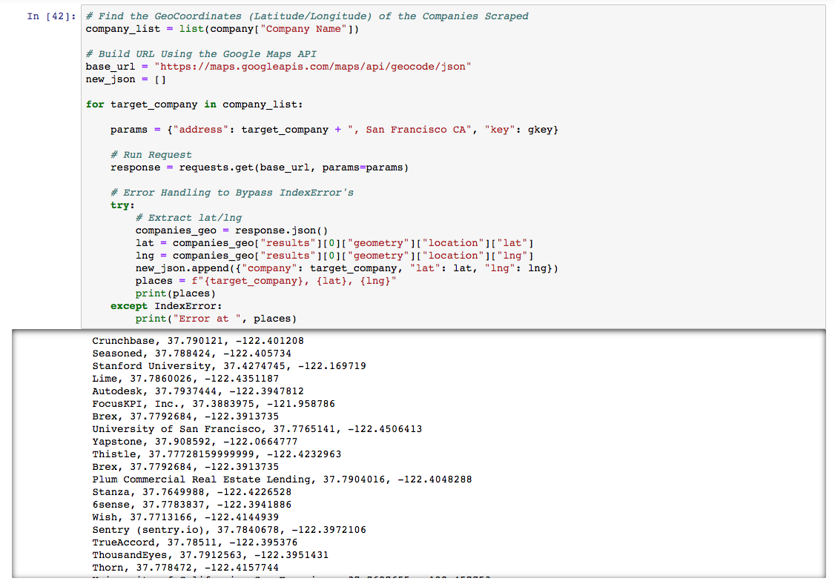
Code Snippets – Google Maps API Geo-Coordinates

Slide 7
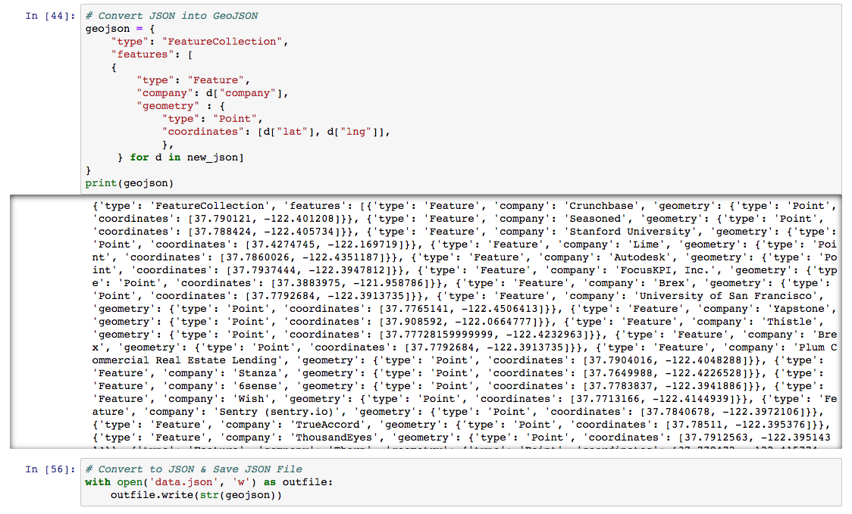
Code Snippets - JSON Data to GeoJSON Data

Slide 8
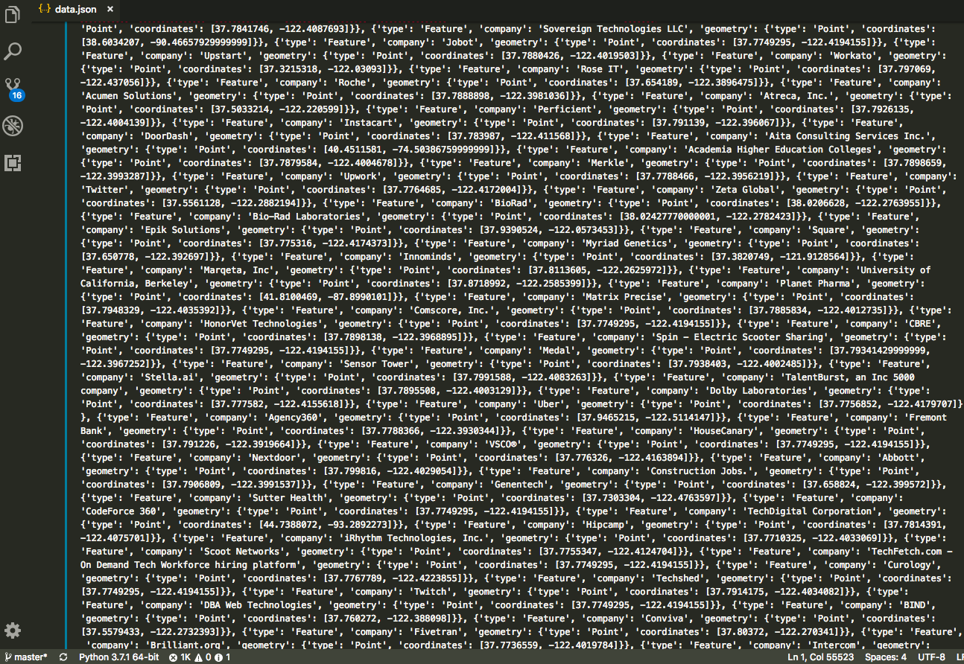
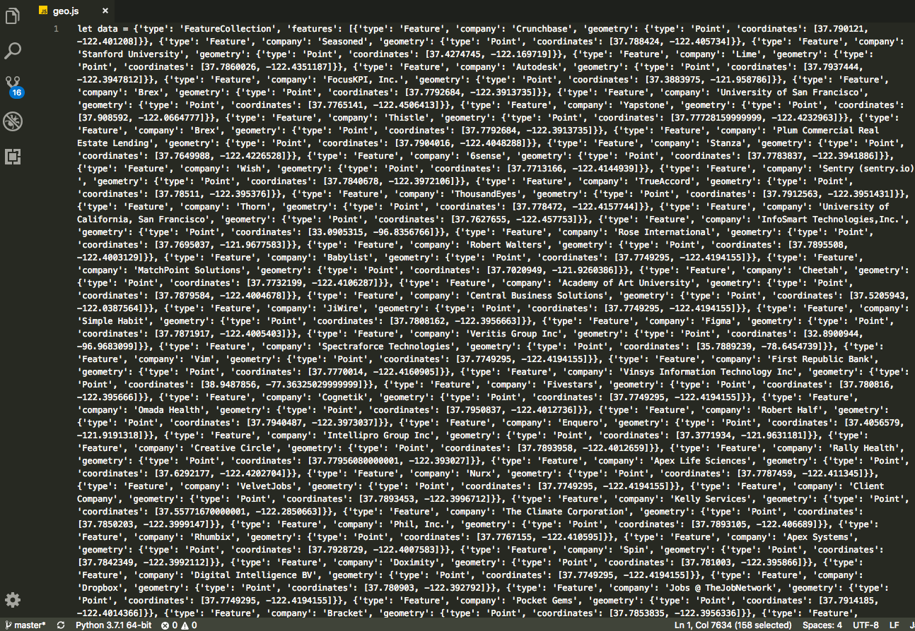
Code Snippets – JSON Geo-Coordinates

Slide 9
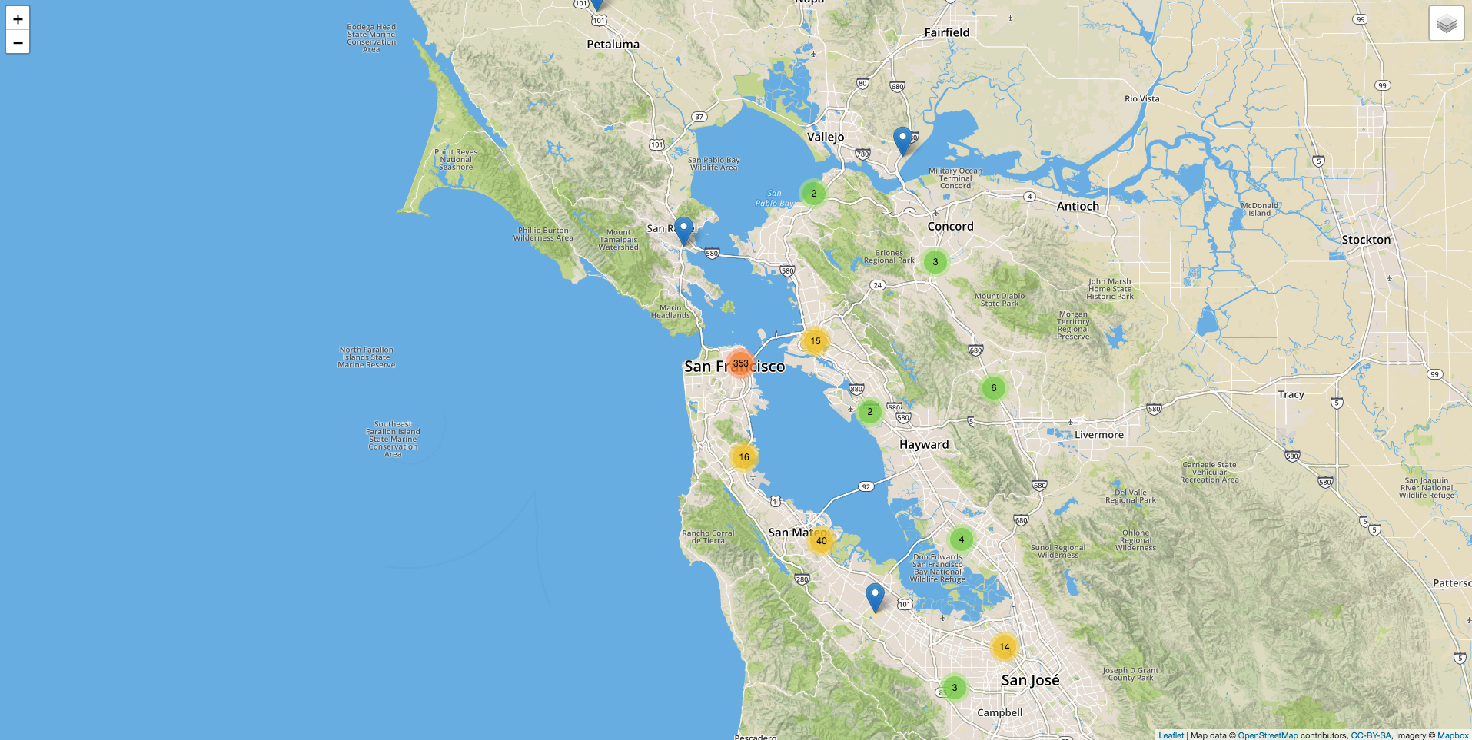
Leaflet Map I

Slide 10
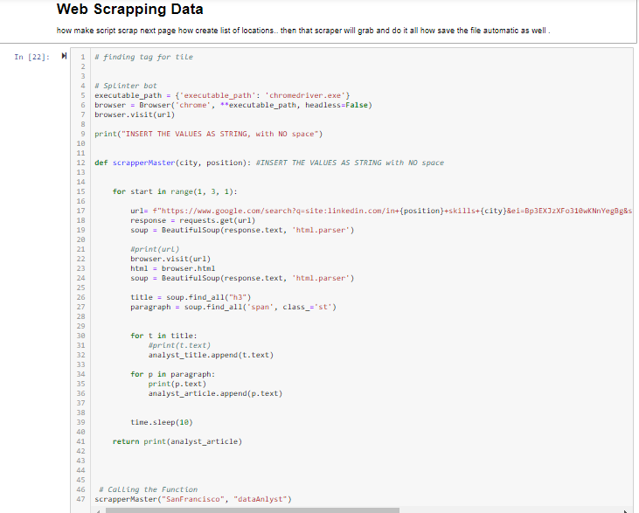
Piter’s Code Snippets

Slide 11
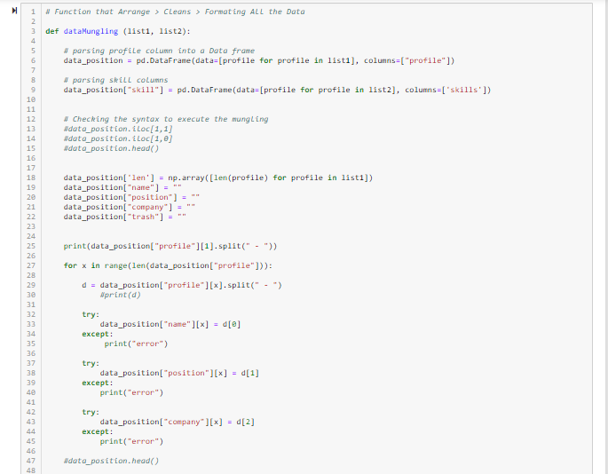
Piter’s Code Snippets

Slide 12
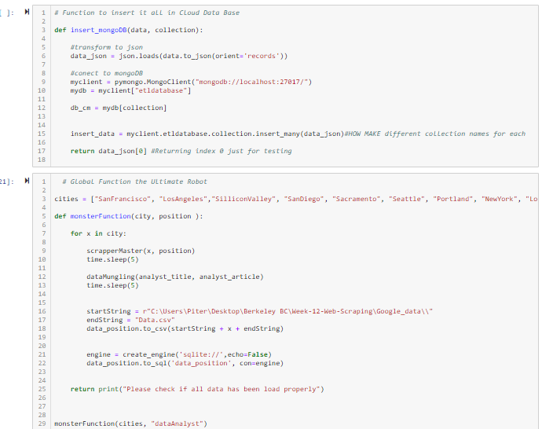
Piter’s Code Snippets

Slide 13
Conclusion
Data Analytics jobs are concentrated in downtown San Francisco
Particularly the Financial District

Slide 14
Next Steps
Apply Machine Learning to Predict Hiring Success
How Does a Company Select and Hire a Candidate (Outside the Interview Process)?
What are the Combinations of Skills, Experience and Education Required, at Minimum, to Get an Interview?
Find Correlations Between Employees (Currently Working) vs. Companies Hiring for those Positions
Ex: Data Analysts at Google vs. Data Analyst Job Listings at Google

